Slide 1

Reliability Design

Slide 2
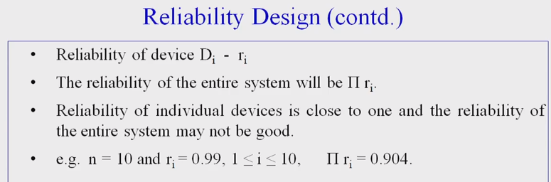


Slide 3
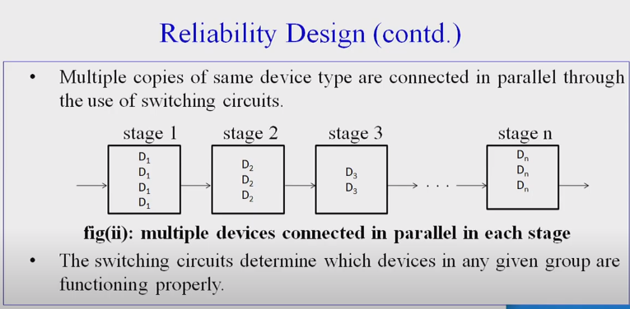

Slide 4
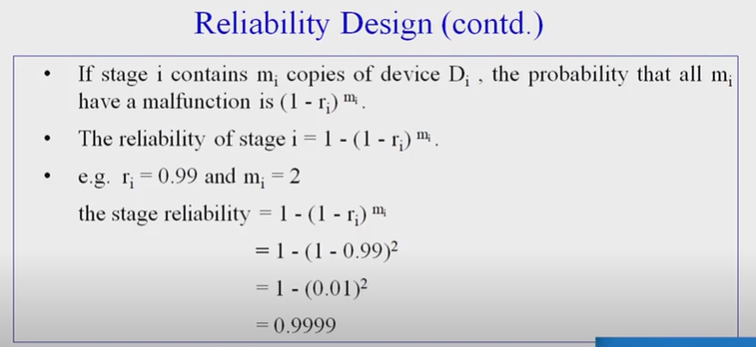

Slide 5
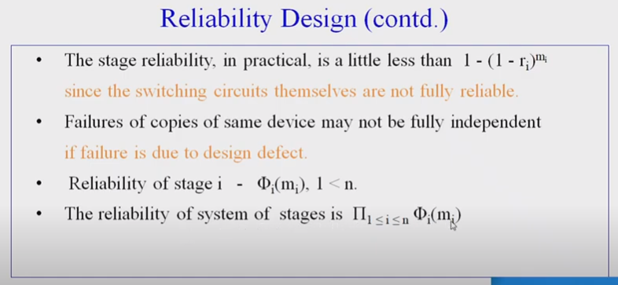

Slide 6
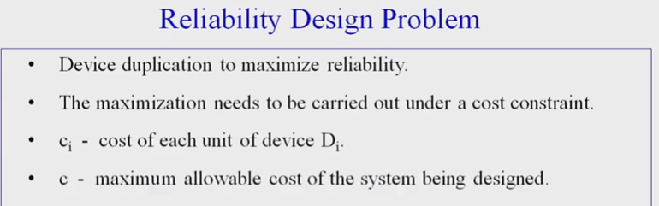
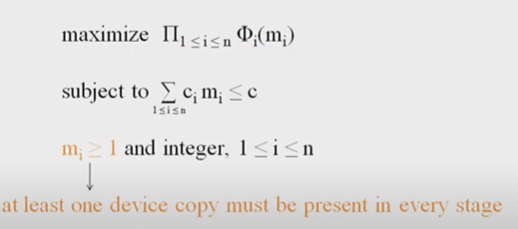
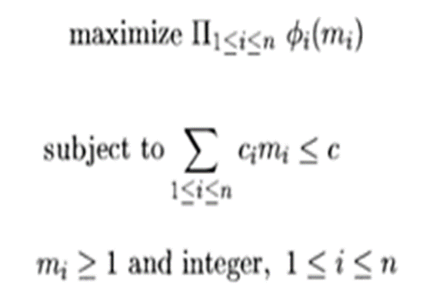

Slide 7
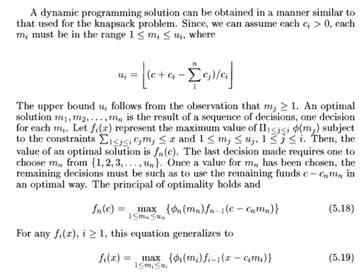

Slide 8


Slide 9
Example 1:
Design a three stage system with device types D1, D2 and D3. The costs are $30, $15 and $20 respectively. The Cost of the system is to be no more than $105. The reliability of each device is 0.9, 0.8 and 0.5 respectively.
Solution:
We assume that if if stage I has mi devices of type i in parallel, then φ i (mi) =1 – (1- _{ri)}mi
Using the above equation compute u1, u2 and u3.
105+ 30− (30+15 + 20)
= =
u
70
1
30
105+15− (30+15 + 20)
15
₃₀ = 2
55
u₂ =
= = 3
15
105+ 20− (30+15 + 20) 60
u3 =
= = 3 20
20

Slide 10
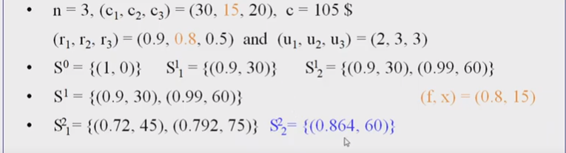
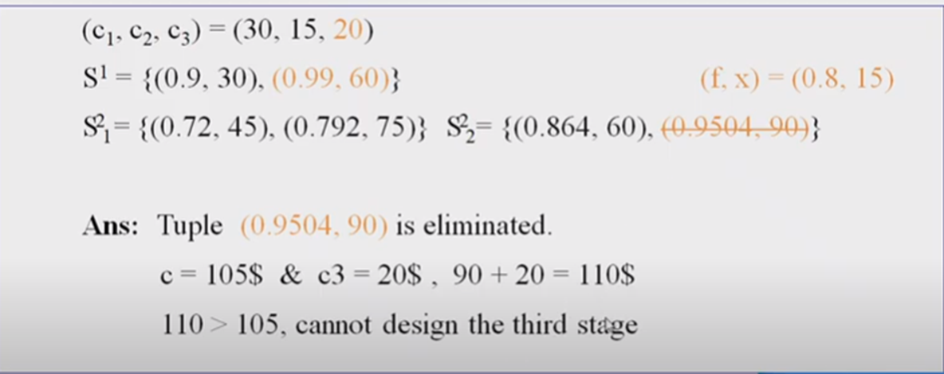
Method –I(Set Method)

Slide 11
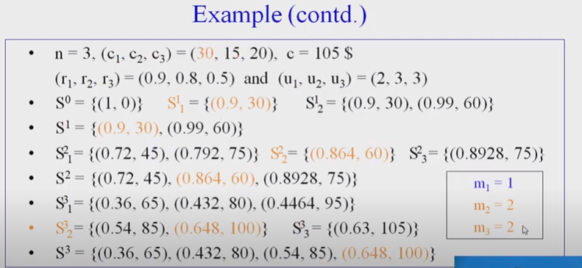
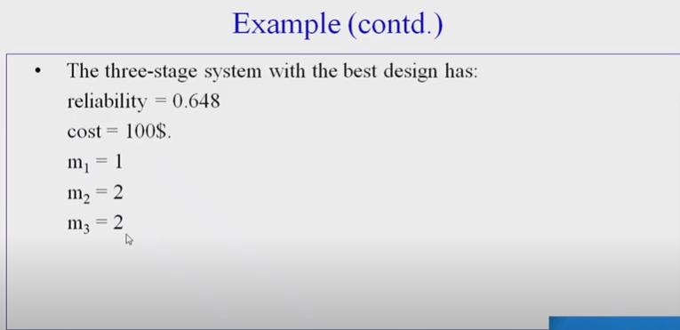

Slide 12
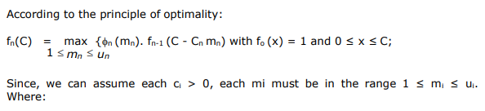
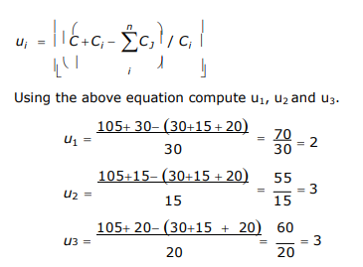
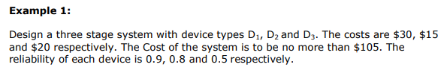
Method II

Slide 14
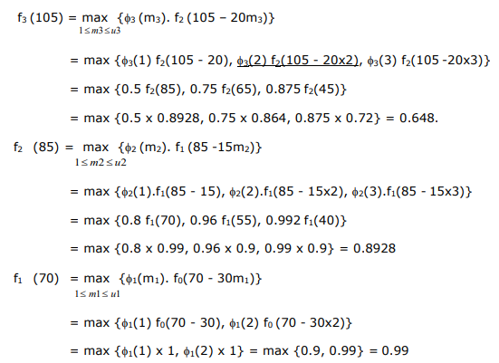

Slide 15
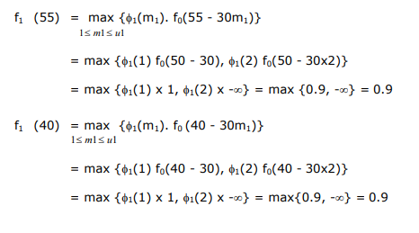

Slide 16
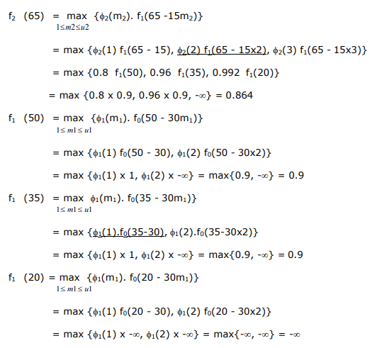

Slide 17
